Slide 1
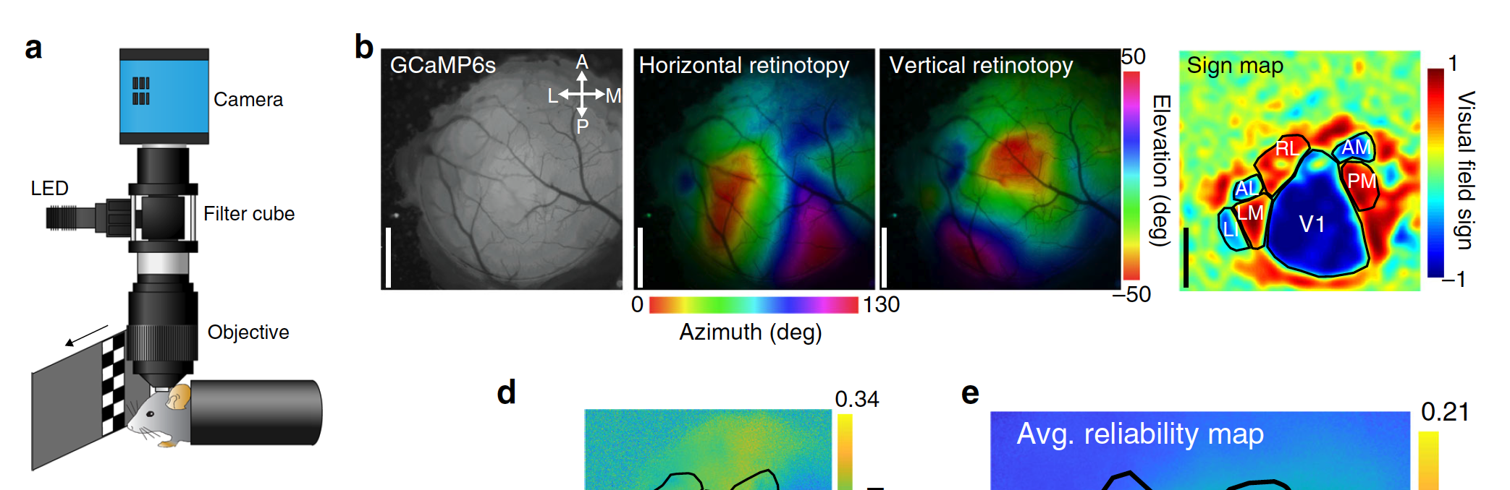
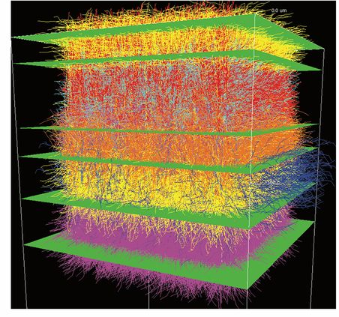
Mesoscale calcium responses in murine visual cortex
Primary visual cortex (V1) in mice contains neurons sensitive to position, orientation, …
Higher visual areas (HVAs)
1mm
6 layers
retinotopic organization
radius of ~800 um
~230k neurons
~100 um deep for wide-field
LED excitation (GFP)
4mm X 4mm (400 X 400 px), CMOS
Distributed and retinotopically asymmetric processing of coherent motion in mouse visual cortex. Nature Communications. 2020
Notes:
This hypothesis raises several questions: What information do you need to choose a subset? What does it mean for a subset to outperform another?
I believe the subset you choose should be informed by the stimulus you are presenting and a hypothesized response to that stimulus, given known signaling pathways
V1 is the primary visual cortex and the first stage of processing of information coming in from the lateral geniculate nucleus (LGN) of the thalamus. It sends its output
to other higher visual areas (HVAs). V1 can be accessed by optical techniques since it lies near the surface. If we can go as deep as …
Feed-forward inputs from LGN arrive in layer 4, with collaterals to layer 6, and feedback inputs from other cortical areas arrive mostly in superficial layers.
Feed-forward outputs to other cortical areas depart from layer 2/3, feedback outputs to the thalamus depart from layer 6, and outputs to other subcortical targets depart from layer 5.
One of the interesting things about the visual cortex is that there exists a coordinate transformation between a point in the visual field
and a point on the cortical surface. Retinotopic maps provide such a mapping. That mapping can be measured experimentally by exposing
the system to a continuous periodic stimulus with frequency far from the system’s internal oscillation frequencies. You can
then filter out the response using a Fourier decomposition. Hemodynamics: heart-beat, respiration rate, state of the subject.
You can stay away from these artifacts by choosing a stimulus with frequency from 0.1-0.3Hz or below 0.05Hz.
One of the obvious limitations of mesoscopic imaging is that wide-field imaging cannot penetrate very deep. If this is meant to inform the two-photon
focal volume, then the two-photon imaging shares that limitation. Nevertheless it does provide some calibration.
The lateral geniculate nucleus (LGN) receives inputs from the retina and passes those signals to V1 and other HVAs. Lateral medial (LM) and lateral intermediate (LI) areas project to
the ventral stream (associated with object recognition and for, the “what”). Anterolateral (AL), rostrolateral (RM), posterior medial (PM), anteromedial (AM) project
to the dorsal stream (the “where” and “how”). Directional selectivity

Slide 2
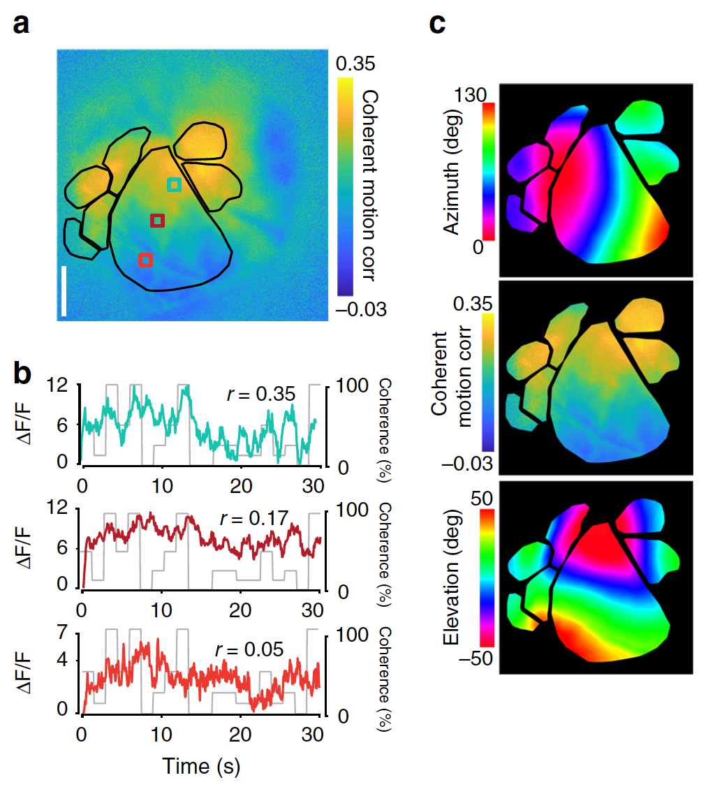
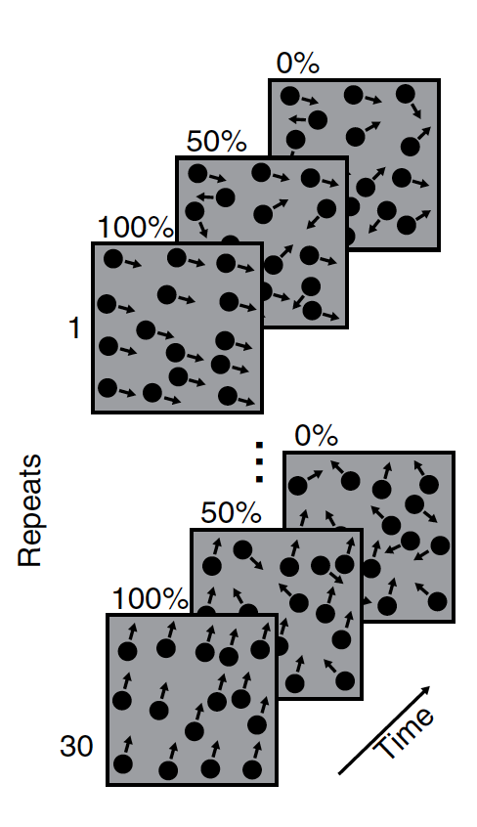
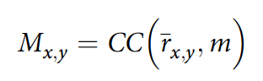
Mesoscale calcium responses in murine visual cortex
Distributed and retinotopically asymmetric processing of coherent motion in mouse visual cortex. Nature Communications. 2020
Notes:
This hypothesis raises several questions: What information do you need to choose a subset? What does it mean for a subset to outperform another?
I believe the subset you choose should be informed by the stimulus you are presenting and a hypothesized response to that stimulus, given known signaling pathways
V1 is the primary visual cortex and the first stage of processing of information coming in from the lateral geniculate nucleus (LGN) of the thalamus. It sends its output
to other higher visual areas (HVAs). V1 can be accessed by optical techniques since it lies near the surface. If we can go as deep as …
Feed-forward inputs from LGN arrive in layer 4, with collaterals to layer 6, and feedback inputs from other cortical areas arrive mostly in superficial layers.
Feed-forward outputs to other cortical areas depart from layer 2/3, feedback outputs to the thalamus depart from layer 6, and outputs to other subcortical targets depart from layer 5.
One of the interesting things about the visual cortex is that there exists a coordinate transformation between a point in the visual field
and a point on the cortical surface. Retinotopic maps provide such a mapping. That mapping can be measured experimentally by exposing
the system to a continuous periodic stimulus with frequency far from the system’s internal oscillation frequencies. You can
then filter out the response using a Fourier decomposition. Hemodynamics: heart-beat, respiration rate, state of the subject.
You can stay away from these artifacts by choosing a stimulus with frequency from 0.1-0.3Hz or below 0.05Hz.
One of the obvious limitations of mesoscopic imaging is that wide-field imaging cannot penetrate very deep. If this is meant to inform the two-photon
focal volume, then the two-photon imaging shares that limitation. Nevertheless it does provide some calibration.
The lateral geniculate nucleus (LGN) receives inputs from the retina and passes those signals to V1 and other HVAs. Lateral medial (LM) and lateral intermediate (LI) areas project to
the ventral stream (associated with object recognition and for, the “what”). Anterolateral (AL), rostrolateral (RM), posterior medial (PM), anteromedial (AM) project
to the dorsal stream (the “where” and “how”). Directional selectivity

Slide 3
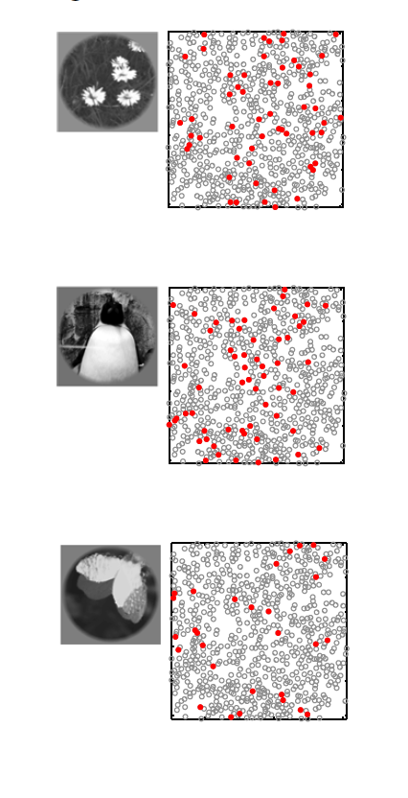
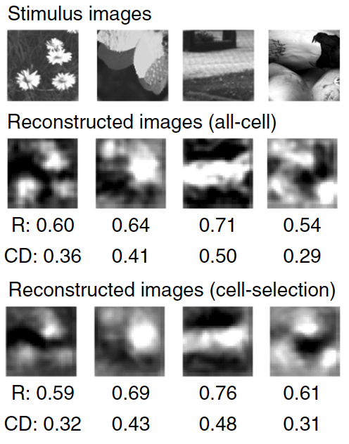
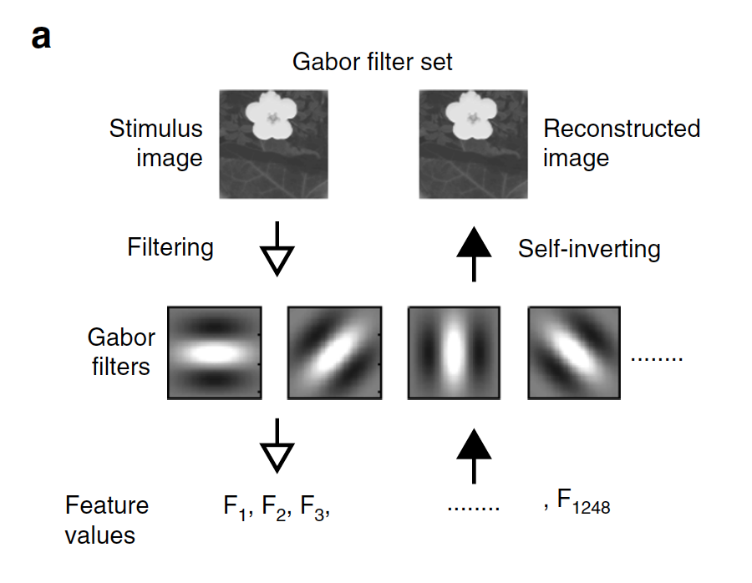
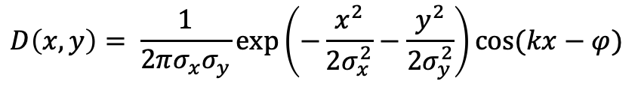
Population decoding in V1
V1 has a retinotopic organization - it is composed of simple and complex cells distinguished by their receptive field
$$D\left(x,y\right)= \frac{1}{2πσ_{x}σ_{y}}\exp\left(−\frac{x^{2}}{2σ_{x}^{2}}−\frac{y^{2}}{2σ_{y}^{2}}\right)cos⁡(kx−φ)$$
pixel-to-pixel pearson correlation
560 (284-712) cells/plane – median (25th-75th percentile)
2D two-photon imaging of GCaMP6s in mouse V1. 920nm excitation, FOV: (338 X 338 um) @ 30Hz
Natural images are reliably represented by sparse and variable populations of neurons in the visual cortex. Nature Communications. 2020
Notes:
A simple cell can be approximated by a Gabor filter (a product of a 2D elliptical gaussian and a cosine function) of the stimulus
For each neuron, select the Gabor features that are strongly correlated with the response
What is the optimal decoding strategy? Do sparsely active neurons reliably represent the stimulus under trial to trial variability?
The contents of an image were linearly decodable from a small number of highly responsive neurons

Slide 4
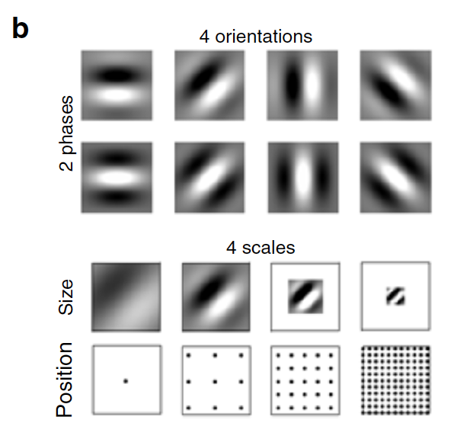
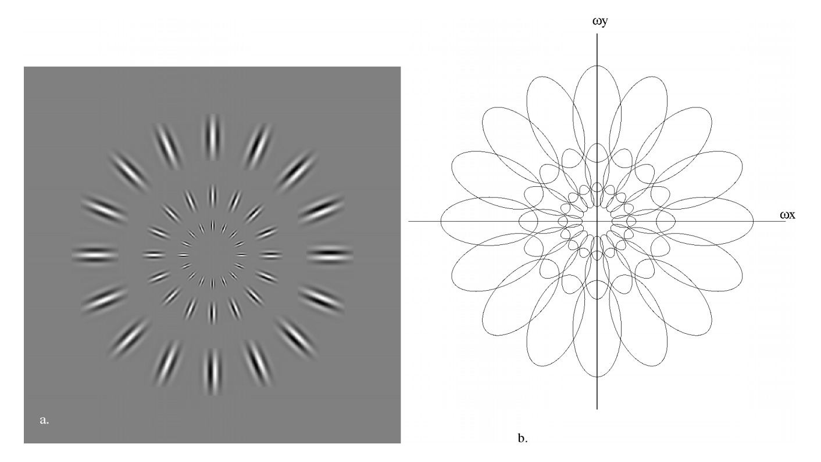
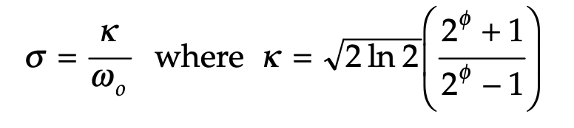
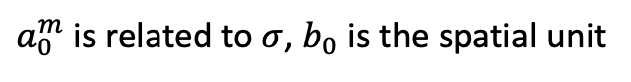
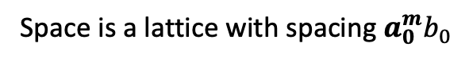
Frequency domain
Spatial domain
8 + 9*8 + 25*8 + 121*8 = 1248
$λ=1.5−2.0$ for simple cells, HMB ~1.5 octaves
Wave vector is orthogonal to major axis
Space is a lattice with spacing $a_{0}^{m}b_{0}$
HMB [octaves]
inverse prop to spatial frequency
scale dependent spacing
$a_{0}^{m}$ is related to $σ$, $b_{0}$ is the spatial unit
Image representation using 2D Gabor wavelets. IEEE. 1996
Notes:
There is a uncertainty principle similar to Heisenberg’s uncertainty principle for the
The signal can be encoded by projecting it onto a set of Gabor wavelets, but what defines the set? What constraints on that set exist for an accurate reconstruction?
We need to quantize the params of a Gabor wavelet but how does the visual cortex perform this quantization i.e. how does it allocate neurons for different params?
-------------------------------
The spatial domain is sampled by each wavelet in a scale-dependent spatial lattice. The discretized wavelets at each m-level cover the entire spatial domain

Slide 5
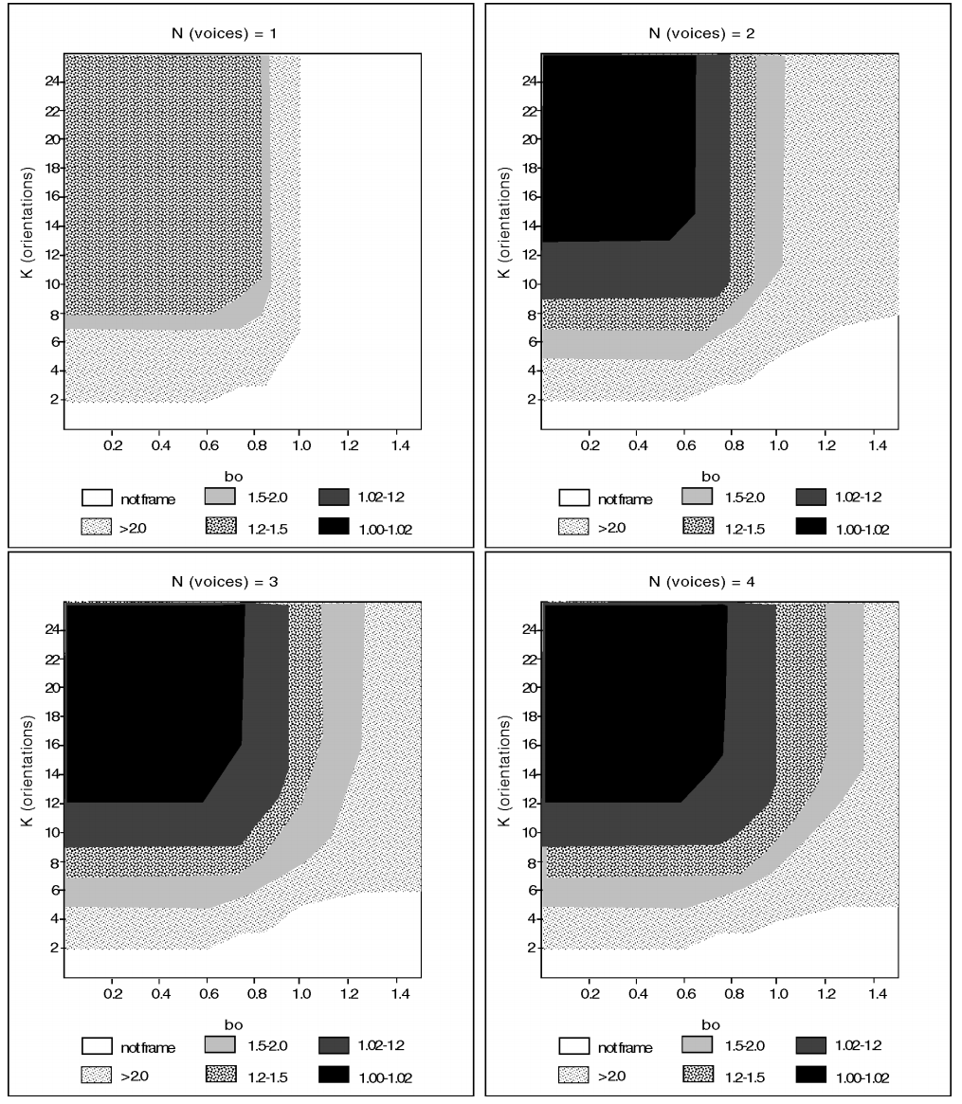
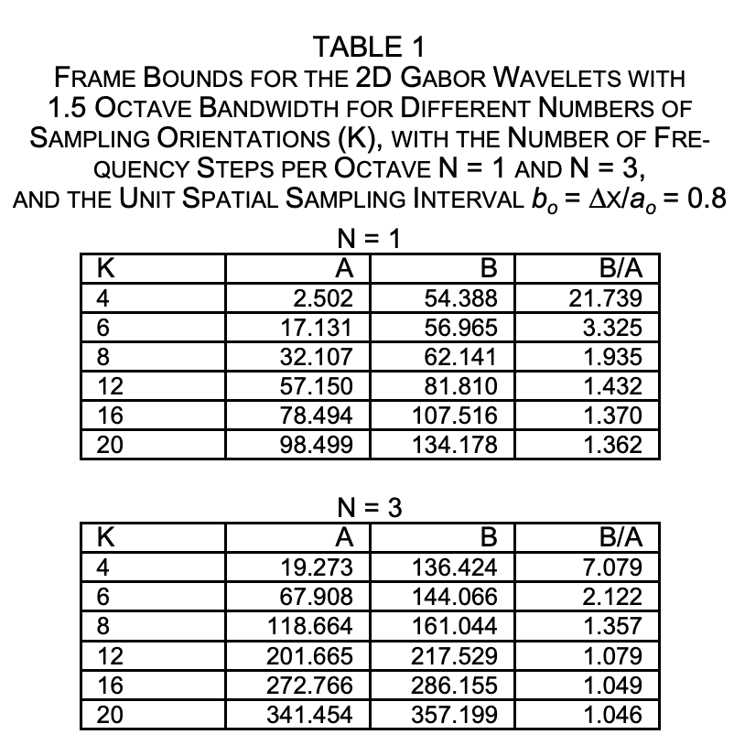
Image reconstruction experiments
B/A = 1 is a “tight-frame” which achieves perfect reconstruction
Image representation using 2D Gabor wavelets. IEEE. 1996

Slide 6
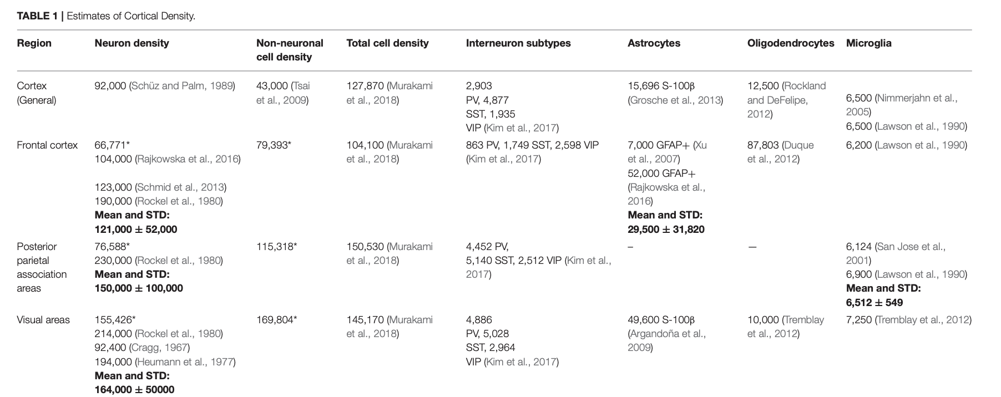
cells/mm^3
Notes:
Can you break down that number based on the RF?

Slide 7
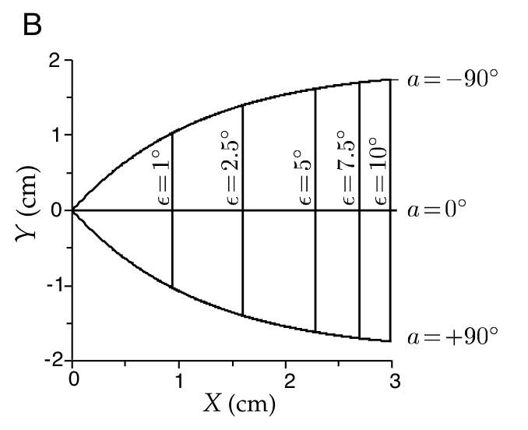
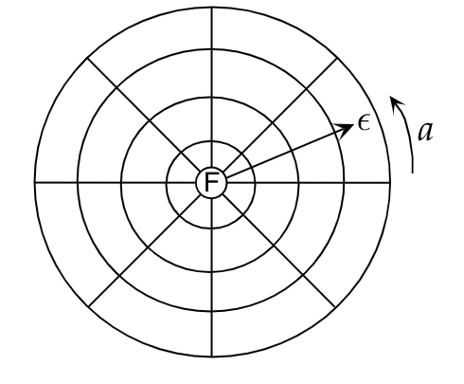
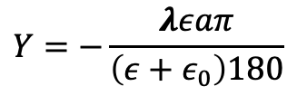
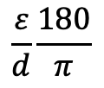
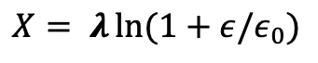

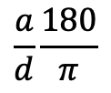
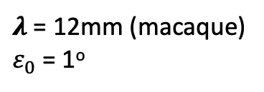
Effect of stimulus image size/orientation
RV1
LV1
$$\frac{ε}{d}\frac{180}{π}$$
$$\frac{a}{d}\frac{180}{π}$$
Let $(X,Y)$ be cortex coordinates
$λ$ = 12mm (macaque)
$ε_{0}$= 1º
$$X= λ\ln{(1+ε/ε_{0})}$$
$$Y=−\frac{λεaπ}{\left(ε+ε_{0}\right)180}$$
Scaling or rotation is translation on the cortical surface
Theoretical Neuroscience. Wiley

Slide 8
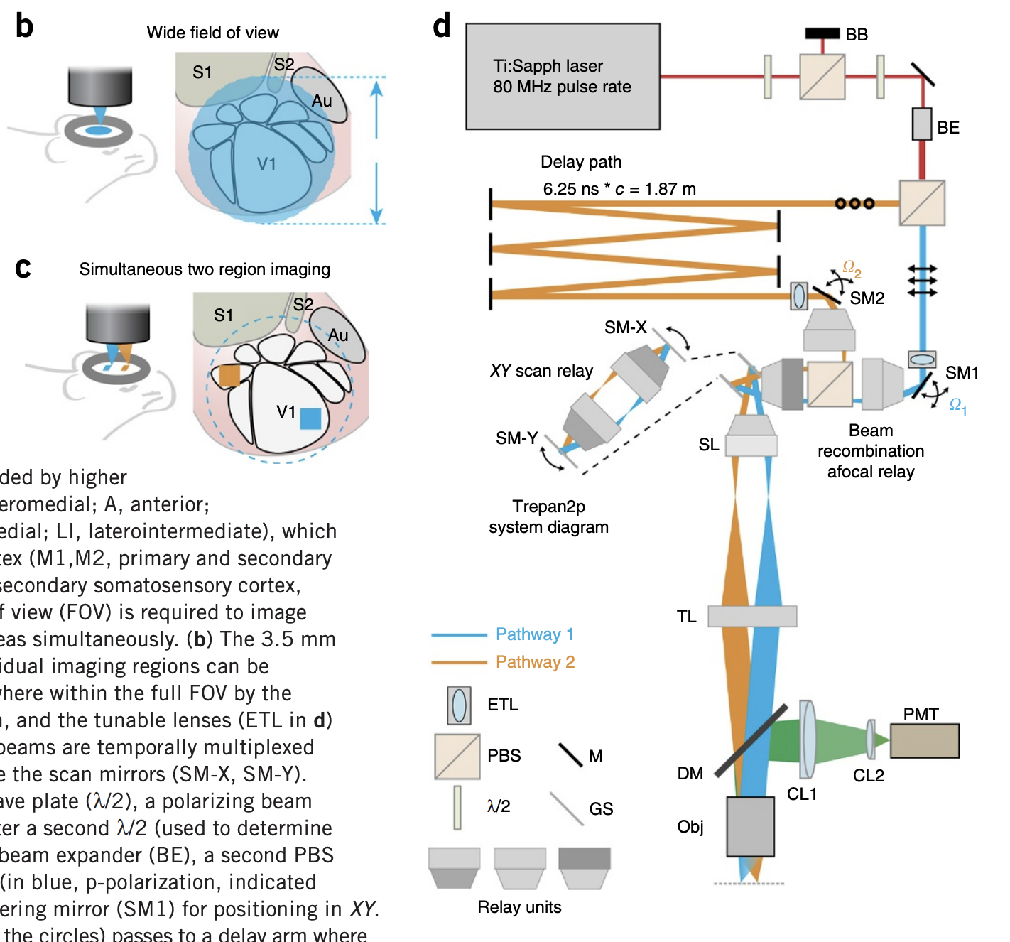
Breaking down an existing system
3.5mm
512 x 256 pixels @ 30 frames/s per region, 2D galvo scanning
Wide field-of-view, multi-region, two photon imaging of neuronal activity in the mammalian brain. Nature Biotechnology. 2016

Slide 9
Efficient Coding Hypothesis: Sensory systems have evolved to transmit maximal information about incoming signals given internal resource constraints (noise, metabolic cost)
Information Bottleneck (IB): Encode X to maximize fidelity while constraining the coding capacity
X
Encoder
R
Channel
S
Decoder
X’
Goal of the paper: Unify efficient coding hypothesis with predictive and sparse coding
Toward a unified theory of efficient, predictive, and sparse coding. PNAS. 2018

Slide 10
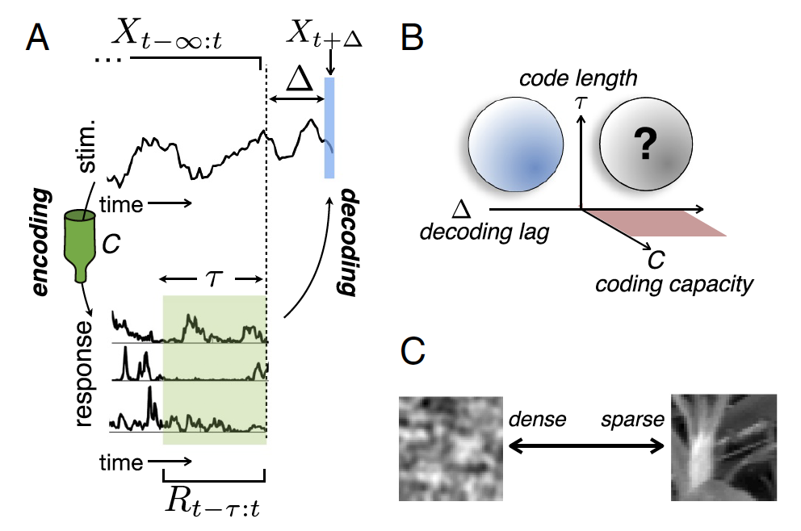
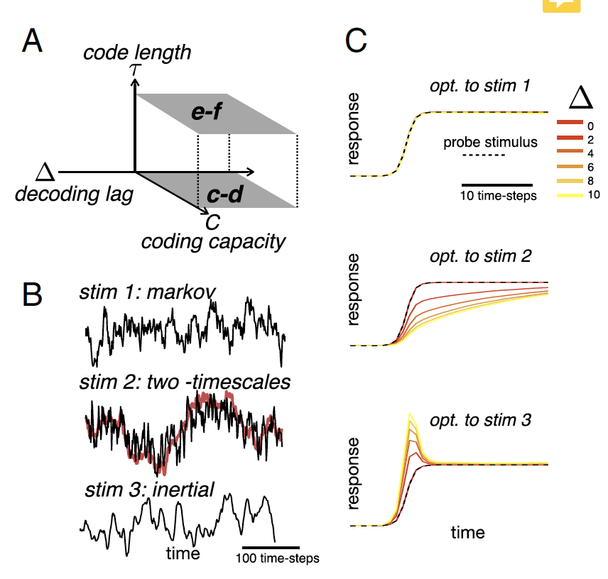
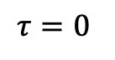
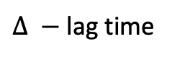
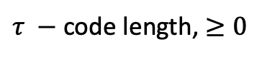
Using IB to predict neural responses
Parameter space
Encoding filters
$$τ=0$$
Low-pass
High-pass
$τ −$code length, $≥0$
$∆ −$ lag time
$C −$ coding capacity (relates to SNR, determines number of neurons)
Toward a unified theory of efficient, predictive, and sparse coding. PNAS. 2018
Notes:
Information bottleneck (IB) is an algorithm for finding the optimum tradeoff between accuracy and compression when summarizing a random variable.
The metric of accuracy is the mutual information between the stimulus and response
Unifying framework where different values of the parameters correspond to existing theories

